Slide 1

IBM University Engagement Project Submission
“Exploring the Power of Agentic AI with IBM Granite and IBM Bob”

Slide 2

Project Tile – AI Job & Internship Scam and Offer Verification Agent
Domain of Project – Digital Trust / Career & Employment Safety
Student Name | Recent Passport Photo | Email ID | Mobile number [WhatsApp]
Simarpreet Kaur Bhatia |  | skbhatia55555@gmail.com | 9302458965

Slide 3
Problem Statement -
Problem Statement :AI Job & Internship Scam and Offer Verification Agent
The Challenge
  Students and job seekers increasingly receive fake job and internship offers through online platforms.
  Fraudulent offers may contain unrealistic salaries, fake recruiters, or misleading company details.
  Some scams demand registration, security, training, or other upfront payments.
  Suspicious links, email domains, and offer-letter content can be difficult to identify manually.
  Different pieces of information may be inconsistent across the company, recruiter, job role, and offer letter.
  Users often lack a simple way to verify an offer before sharing information or taking action.
  A need exists for an AI-based system that can identify warning signs and provide clear verification guidance.
Objective
  Extract important details from job/internship offers.
  Verify company, recruiter, domain, and contact information.
  Detect common scam indicators and suspicious patterns.
  Analyze consistency between different offer details.
  Generate an explainable risk score and verification result.
  Provide clear safety recommendations and next steps.

Slide 4
Proposed Solution -
Proposed Solution: AI Job & Internship Scam and Offer Verification Agent
  Offer Submission & Document Processing - Users can upload job/internship offer letters, screenshots, emails, or paste recruitment messages. The system extracts key information such as company name, recruiter, job role, salary, location, payment requests, contact details, and links.
  Company & Recruiter Verification- An AI verification agent checks the available company and recruiter information against public sources. It analyzes the official website, email domain, contact details, and other available information to identify possible mismatches or unverifiable details.
  Scam Indicator Detection - The system analyzes the offer for common warning signs such as registration fees, security deposits, paid training, unrealistic salaries, urgent payment requests, suspicious links, unusual recruitment processes, and requests for unnecessary sensitive information.
  Offer Consistency Analysis - The system compares information across the offer letter, recruiter details, company website, email domain, job description, salary, location, and contact information. Any conflicting or inconsistent information is highlighted as a potential warning sign.
  Explainable Risk Assessment - A dedicated AI agent combines the verification findings and generates an explainable risk score from 0–100. Instead of simply saying “scam” or “genuine,” the system shows the specific indicators that contributed to the risk level.
  Verification Recommendations - Based on the detected risks, the system provides practical next steps, such as verifying the recruiter through official company channels, checking the company domain, avoiding upfront payments, and independently confirming the opportunity.
  Verification Trail & Report Generation -The system maintains a step-by-step verification trail showing how the offer was analyzed—from information extraction to company verification, indicator detection, consistency checking, and final risk assessment. A summarized verification report can also be generated.
  Dashboard & History - Users can view previous offer checks through a dashboard containing risk categories, detected warning signs, verification history, and summarized statistics, helping them compare and review multiple opportunities.

Slide 5
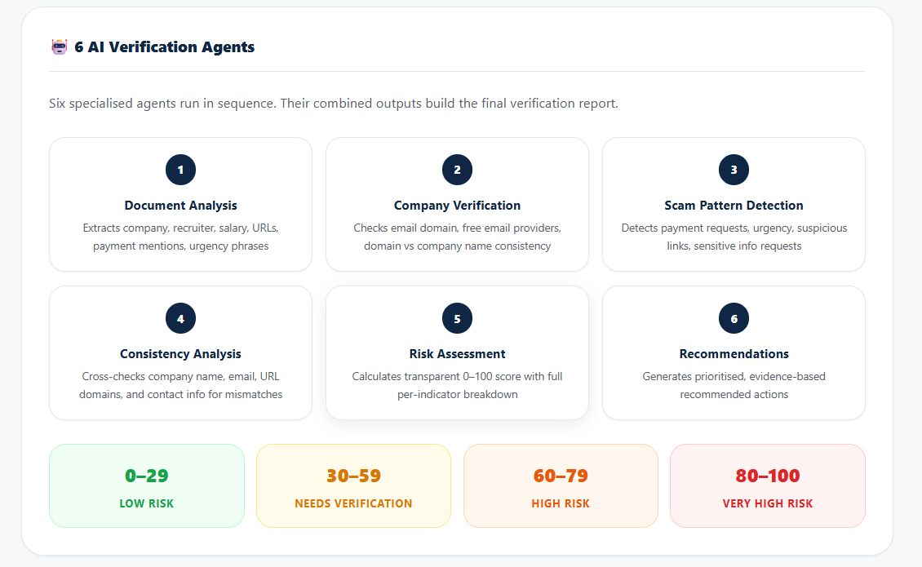
Technology Used
  IBM Bob platform -For designing and orchestrating multi-agent workflows visually
  IBM Grainte model - for eg – ibm-granite-3-2-8b – For natural language understanding, reasoning, and personalization
  RAG– RAG to fetch real data first, then generate intelligent answers, making the Nutrition Agent more trustworthy and effective.

Slide 6
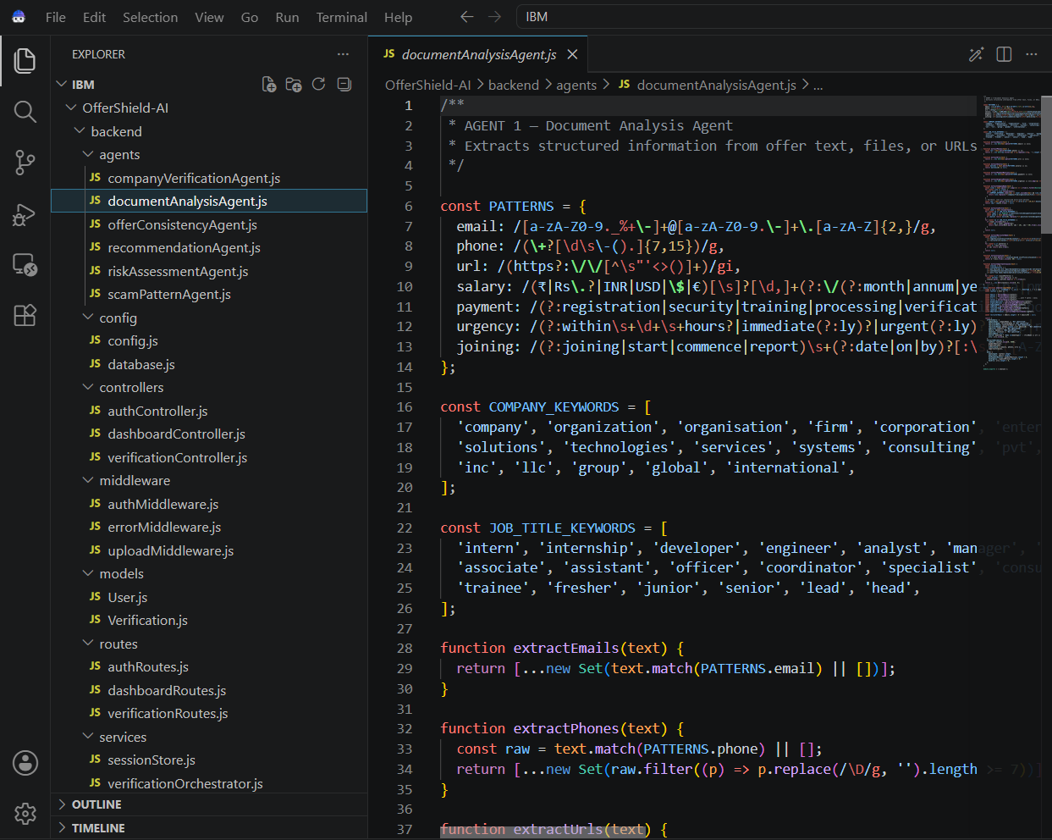
Required Files created using IBM bob -
Frontend
  index.html
  verify.html
  dashboard.html
  report.html
  style.css
  verify.js
Backend
  server.js
  verificationRoutes.js
  verificationController.js
  agentOrchestrator.js
Agents
  documentAnalysisAgent.js
  companyVerificationAgent.js
  scamPatternAgent.js
  consistencyAgent.js
  riskAssessmentAgent.js
  recommendationAgent.js
RAG
  ragService.js
  knowledge-base/
  vectorStore/

Slide 7
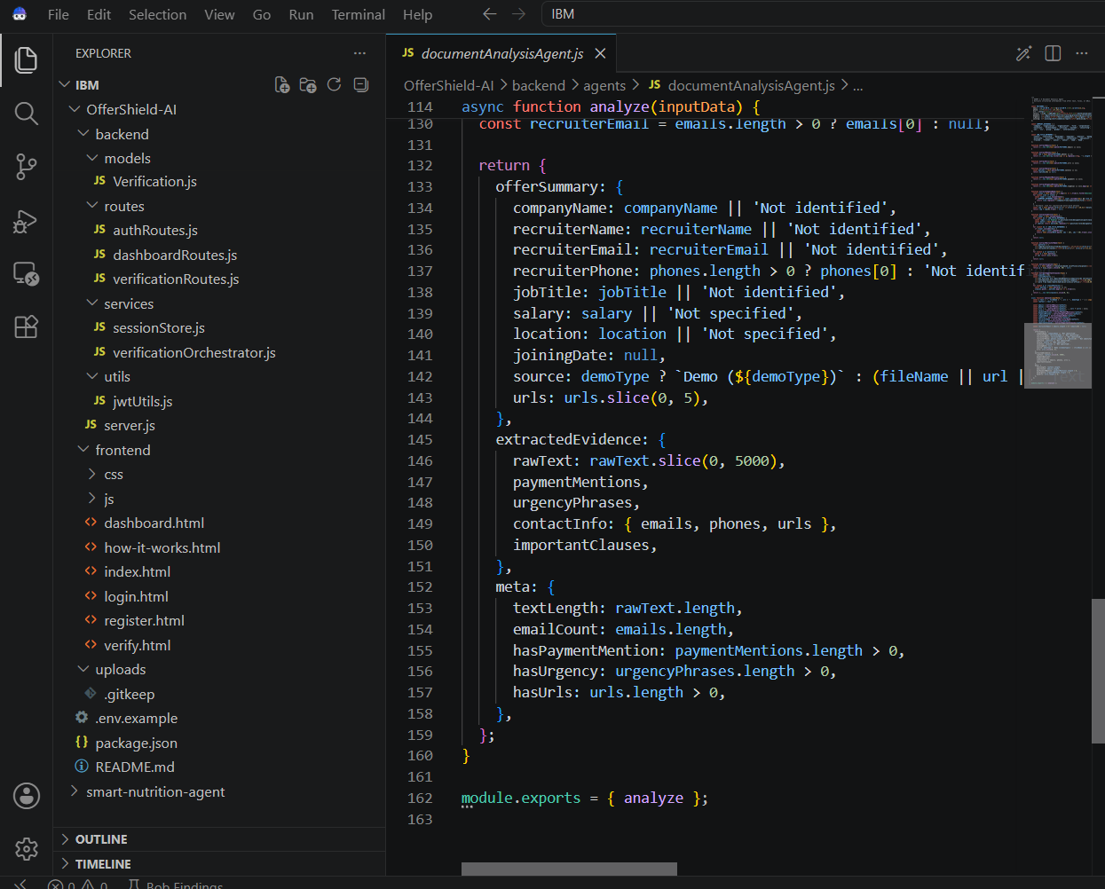
IBM Bob Screenshots:

Slide 8
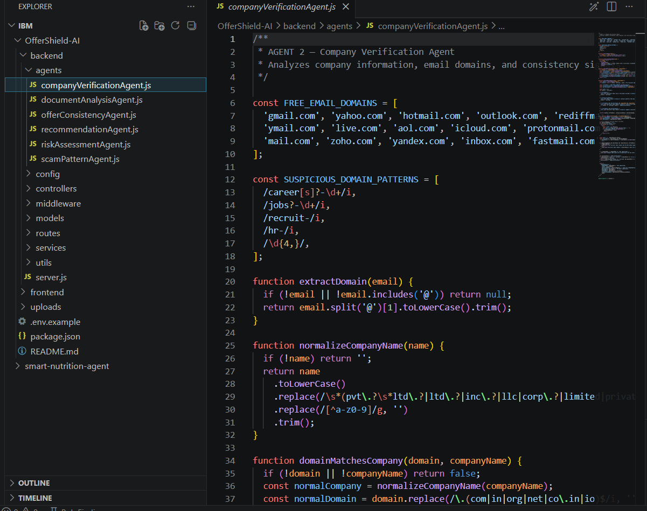

Slide 9

Role of Agentic AI in the solution
Role of Agentic AI in AI Job & Internship Scam and Offer Verification Agent
  Agentic AI coordinates multiple specialized agents, allowing OfferShield AI to analyze a job or internship offer through different verification stages rather than relying on a single AI response.
  The Document Analysis Agent extracts key information such as company name, recruiter, job role, salary, location, payment requests, contact details, and links.
  The Company & Recruiter Verification Agent analyzes company identity, official website, email domain, recruiter details, and other available verification information.
  The Scam Detection Agent identifies common warning signs such as upfront fees, unrealistic salaries, suspicious links, urgent requests, and unusual recruitment processes.
  The RAG-based Agent retrieves relevant information from the trusted knowledge base, such as recruitment guidelines and known scam patterns, to provide more reliable contextual analysis.
  The Consistency Agent compares extracted information across the offer, company, recruiter, domain, job description, and contact details to detect inconsistencies.
  The Risk Assessment Agent combines the findings from different agents and generates an explainable risk score, highlighting the reasons behind the assessment.
  Finally, the Recommendation Agent converts the analysis into practical safety guidance, while the Agent Orchestrator manages the complete flow from offer submission → verification → analysis → risk assessment → recommendations → final report.

Slide 10
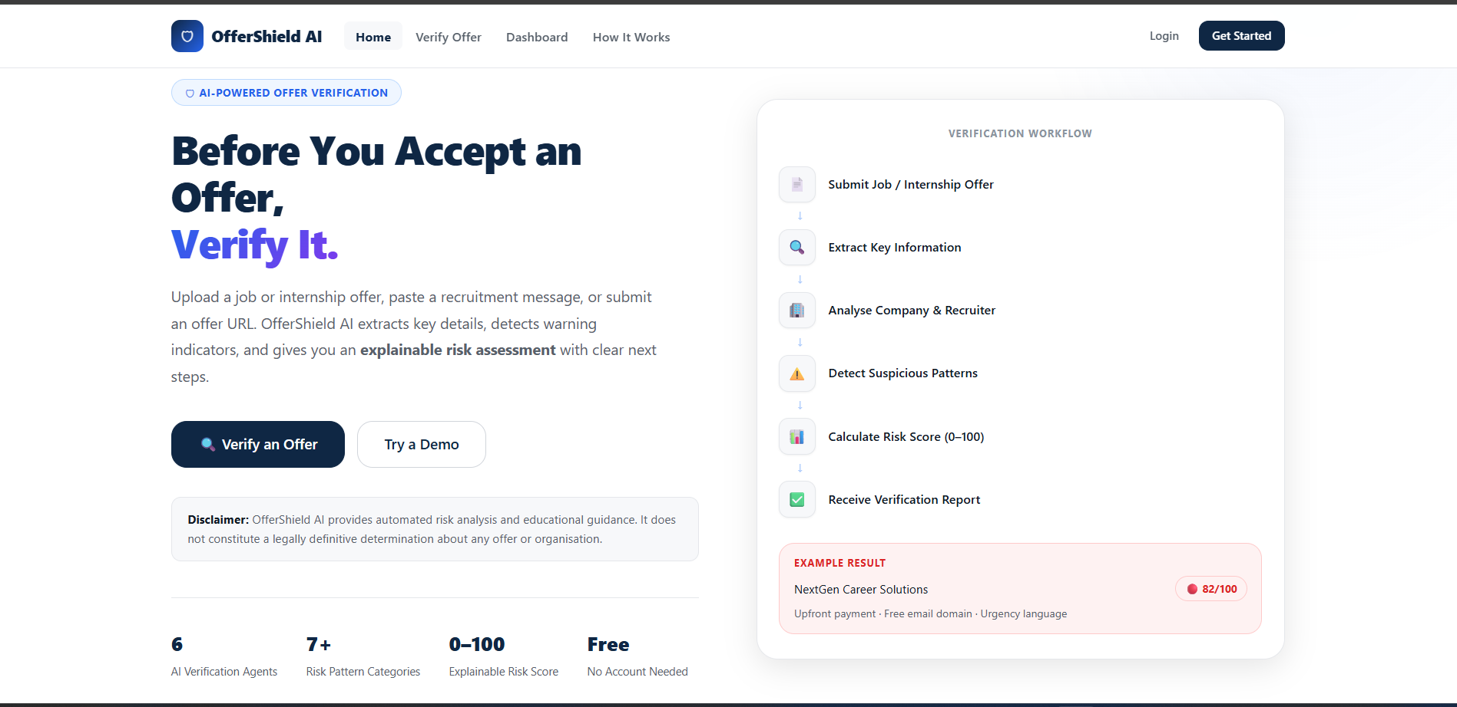
Project Output Screenshot
Please put IBM Bob output screenshots with 2-3 prompts.
You can take 2-3 more slides for each screenshot
·
·
·

Slide 11
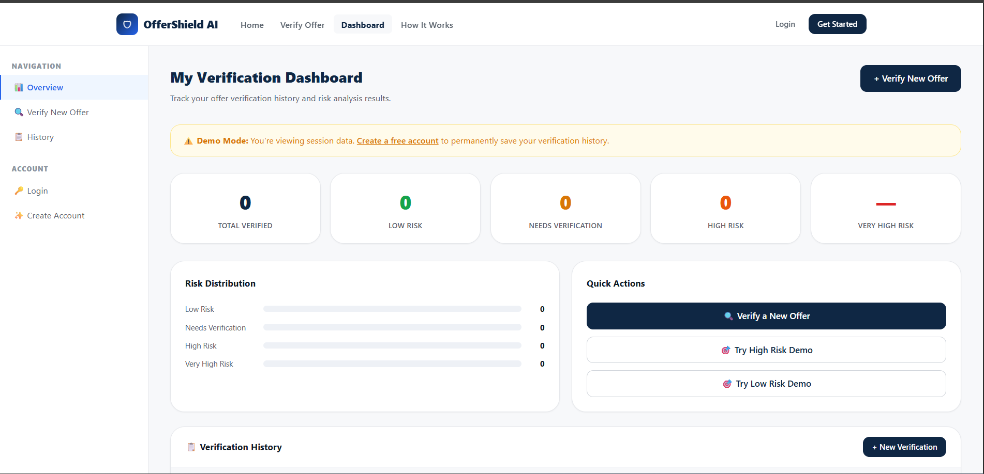
Project Output Screenshot
Please put IBM Bob output screenshots with 2-3 prompts.
You can take 2-3 more slides for each screenshot
·
·
·

Slide 12
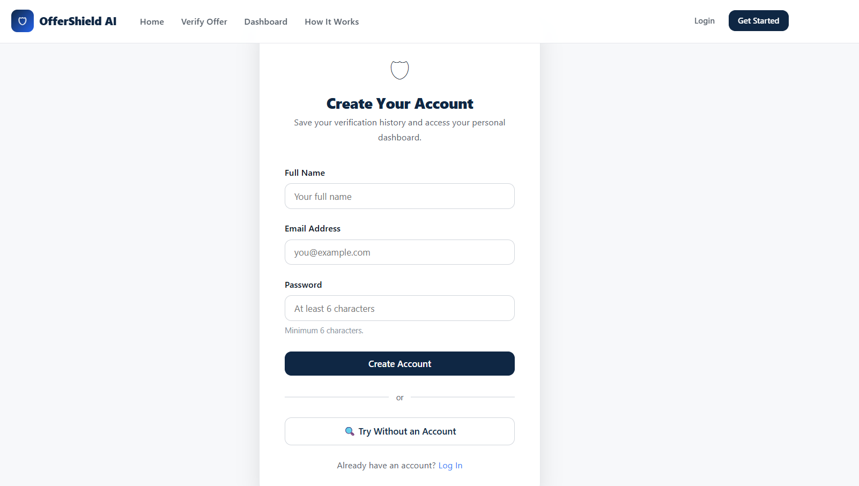
Project Output Screenshot
Please put IBM Bob output screenshots with 2-3 prompts.
You can take 2-3 more slides for each screenshot
·
·
·

Slide 13
Novelty and Uniqueness
  Multi-Agent Verification: Uses multiple specialized AI agents to analyze different aspects of a job or internship offer instead of depending on a single AI response.
  Explainable Risk Score: Provides a 0–100 risk score along with the specific warning indicators responsible for the assessment.
  Verification Trail: Maintains a transparent step-by-step trail from information extraction → verification → scam detection → consistency analysis → risk assessment.
  Cross-Source Consistency Check: Identifies mismatches between the offer letter, recruiter, company, email domain, job description, salary, and contact information.
  RAG-Based Verification: Retrieves relevant recruitment guidelines and known scam patterns to support the AI's analysis with contextual evidence.
  Action-Oriented Safety Guidance: Goes beyond identifying risks by providing practical steps users can take to independently verify the opportunity.
  Unified Offer Verification: Supports PDFs, screenshots, emails, messages, URLs, and pasted job descriptions within one verification platform.
  Proactive Digital Trust Layer: Helps students and job seekers evaluate suspicious opportunities before they make payments, share information, or proceed with the recruitment process.

Slide 14
Git Hub Link
The working Github URL – https://github.com/Simarpreet-Kaur-Bhatia/-AI-Job-Internship-Scam-and-Offer-Verification-Agent---OfferShield-AI

Slide 15
Future Scope
  Real-Time Verification: Integrate live company, domain, email, and recruitment-source verification APIs for more accurate results.
  Browser Extension: Develop a browser extension that can analyze job postings directly from platforms such as LinkedIn and other recruitment websites.
  Email & Messaging Integration: Enable automatic screening of suspicious recruitment emails and messages while maintaining user privacy.
  Advanced RAG Knowledge Base: Continuously update the knowledge base with new scam patterns, recruitment guidelines, and verified information.
  Multilingual Support: Extend the system to analyze job offers and scam indicators across multiple Indian languages.
  Community Reporting: Allow users to report suspicious offers and contribute verified scam information to improve the shared knowledge base.
  Personalized Risk Analysis: Adapt verification and recommendations according to the user's role, experience level, location, and type of opportunity.
  Enterprise & Institutional Deployment: Extend OfferShield AI for use by universities, placement cells, recruitment platforms, and organizations to improve employment-related digital trust.
·
·
·

Slide 16
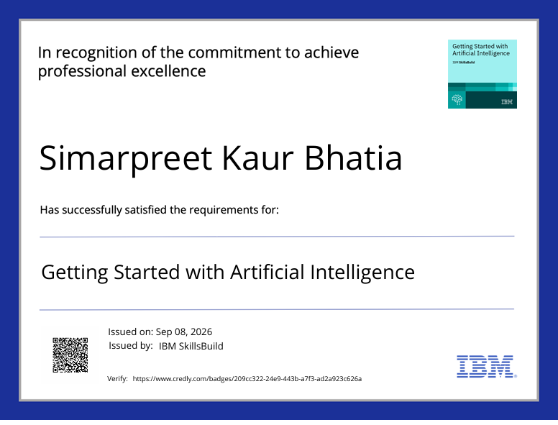
Certificates Earned:
Please add your credly certificate

Slide 17
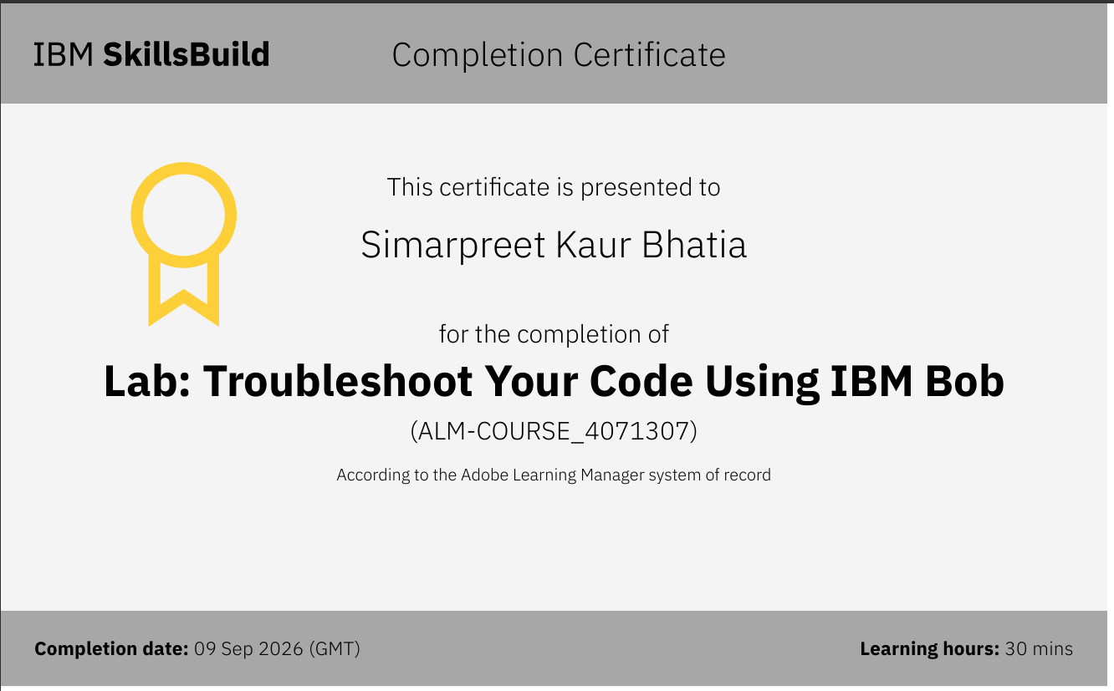
Certificates Earned:​
Add your IBM BOB Certificate

Slide 18


